Slide 1
Generating a sequence using a term-to-term rule
Task A: Using term-to-term rules
This crossnumber is made from sequences written from left to right or from top to bottom. Fill in the crossnumber according to the given rules. Fill in the missing rule for ‘A: down’
A
Across
 | -4
7 | 1 | −5 | −11 | −17 | −23
 | 6 |  | 6 |  | 6
 | 11 |  | 23 |  | 35
4 | 16 | 28 | 40 | 52 | 64 | 76
 | 21 |  |  |  | 93
 | 26 | 50 | 74 | 98 | 122
B
E
F
B: add −6 each time
C: add 12 each time
D: add 24 each time
C
Down
A: add 5 each time
E: add 17 each time
D
F: add 29 each time
2) For each sequence, use the term to term rule to find the desired term.
Start on 2 and add 7 each time. Find the value of T₃
Start on 1 and multiply by 3 each time. Find the value of T₄
Start on 6, double then add 10 each time. Find the value of T₄
Start on 5, add −4 each time. Find the value of T₆
Start on 10, multiply by 2 each time. Find the value of T₇
Start on −4, add 5 each time. Find the value of T₁₀
Start on 24, add −2 each time. Find the value of T₂₅
16 27 111 -15 640 41 -24

Slide 2
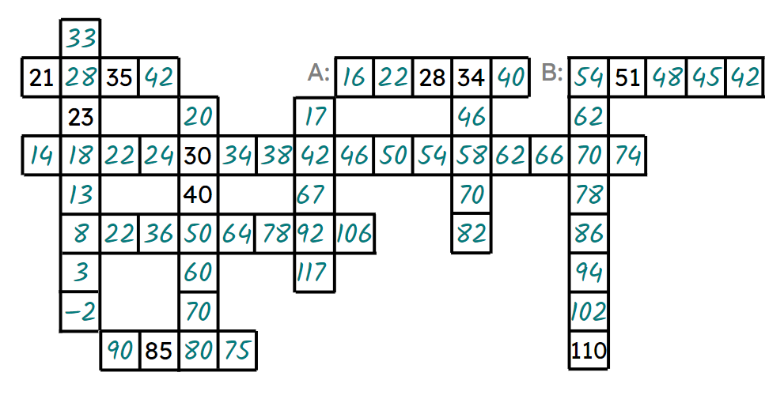
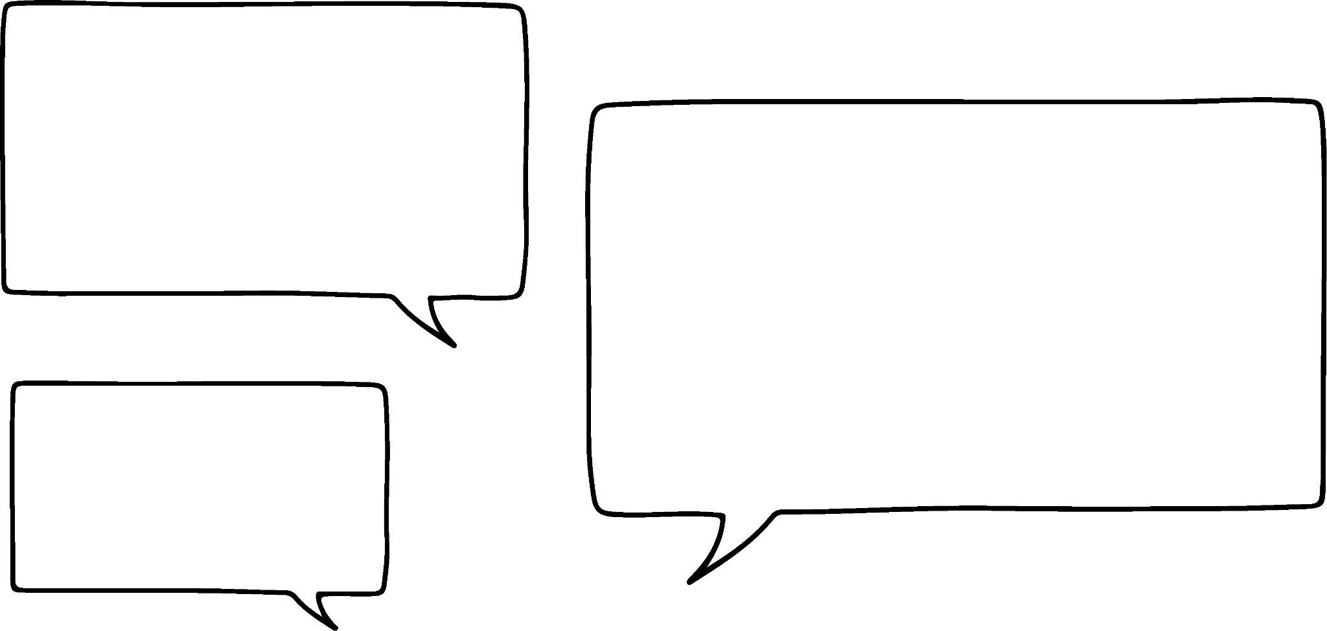

Generating a sequence using a term-to-term rule
Task B: Finding term-to-term rules
Fill in each row and column so they form a sequence with an additive pattern. Then fill in the term-to-term rules for the stated rows.
A term-to-term rule for row A is ‘Add 6’.
A term-to-term rule for row B is ‘Add −3’ or ‘Minus 3’.
2) Describe a term-to-term rule for each sequence below
4, 7, 10, …
13, 26, 52, …
0.2, 2, 20, …
5, −3, −11, …
7, -21, 63, …
2, 5, 11, …
E.g. ‘add 3’
E.g. ‘add −8’
E.g. ‘multiply by 2’
E.g. ‘multiply by −3’
E.g. ‘multiply by 10’
E.g. ‘multiply by 2 then add 1’
or ‘add 3, add 6, add 9, …’
3) Alex and Aisha are writing term-to-term rules for a sequence with T₁= 5 and T₂= 15
Explain why Alex is incorrect
What rules could they have written?
Aisha and I have different rules so one of us must be wrong.
It is possible that multiple rules can apply to the same two terms.
E.g. ‘add 10’, ‘Multiply by 3’, ‘Multiply by 2 then add 5’ ‘Add 10, then 20, then 30, …
Alex
Mathematics in Education and Industry
v2.2

